Slide 1
Task 4
5/12/2023

Slide 2
Track-mAP
IDF1
HOTA
MOTA
Questions

Slide 3
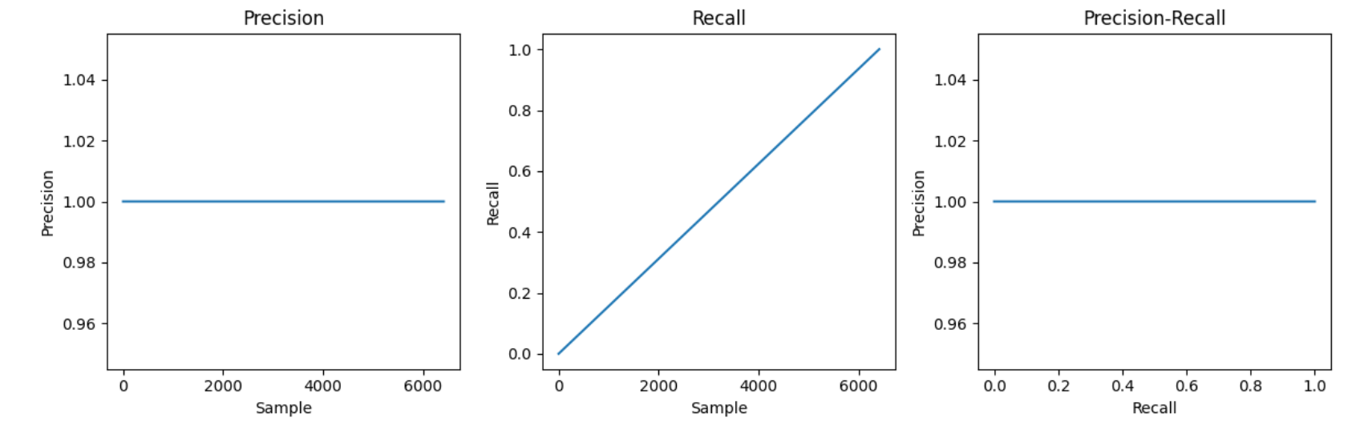
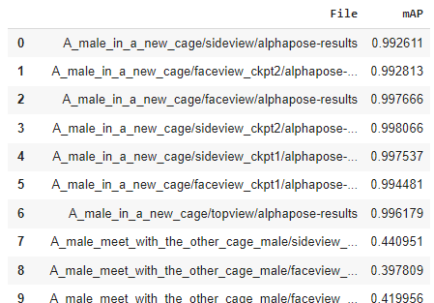
1. Track-mAP
Code: evaluation_mAP.ipynb
Results: evaluation_mAP.json
I checked using gt dataset to test the metrics
Fixed some minor errors in the code
Now the precision and recall values are correctly computed.
AUC = 1
New metrics results uploaded

Slide 4
2. IDF1
Association accuracy
Combines Precision and Recall
Code:
Preprocessing: load predicted ground truth annotations from JSON files
IoU calculation: calculate IoU for each pair of predicted and ground truth boxes
Matching: find the optimal match between predicted and gt boxes based on IoU matrix
Threshold: Count TP if IoU >= 0.5, FP and FN from the difference between total predictions and ground truth boxes.
Calculate IDF1 and aggregate the average IDF1 across all frames

Slide 5
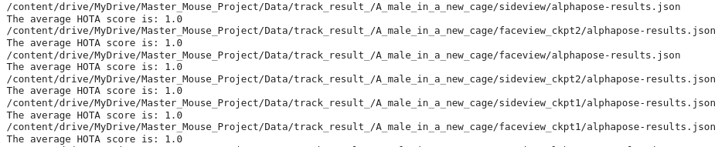
3. HOTA
Fix the metric and test the data with both, gt and pred boxes
Check with caculate_hota_test function
The true results also improved

Slide 6
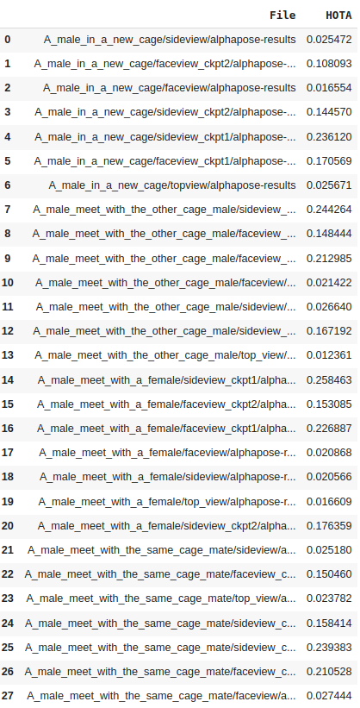
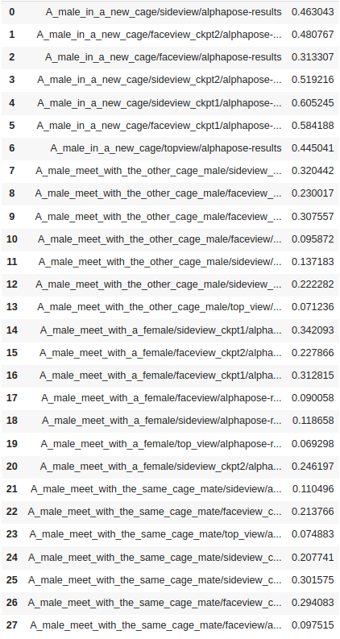

Slide 7
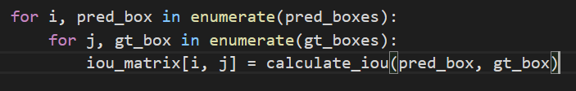
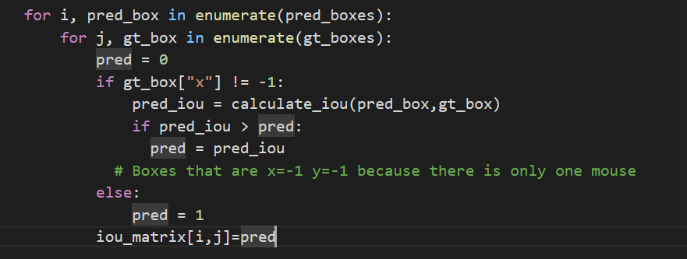

Slide 8
4. MOTA
MOTA stands for "Multiple Object Tracking Accuracy". It is a metric used to evaluate the performance of an object tracking algorithm in computer vision. MOTA takes into account the number of missed detections, the number of false positives, and the number of identity switches between frames in a video sequence.
The compute_mota function takes two lists of bounding boxes, the predicted boxes, and the ground truth boxes, and returns the MOTA score calculated based on their IoU (Intersection over Union).
The calculate_mota function takes two JSON files containing the predicted annotations and the ground truth annotations, respectively. It then reads the annotations for each image, calculates the MOTA score using the compute_mota function, and finally returns the average MOTA score across all the images. The variable alpha is the threshold for the IoU between predicted and ground truth bounding boxes, and it is set to 0.5 by default.

Slide 9
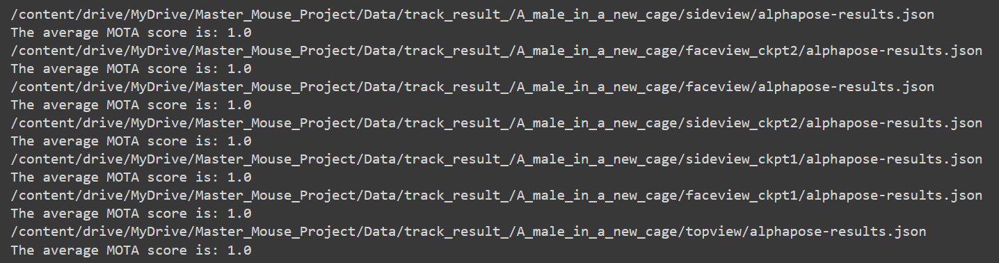
MOTA Evaluation with same files

Slide 10
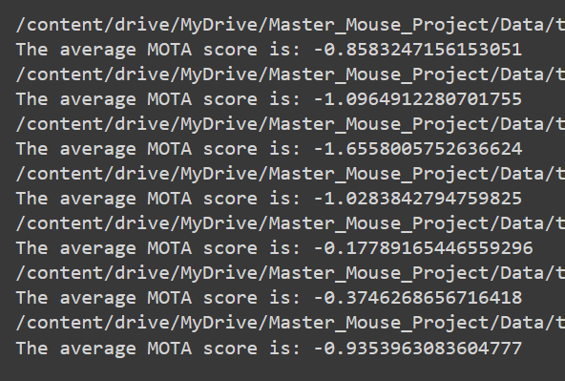
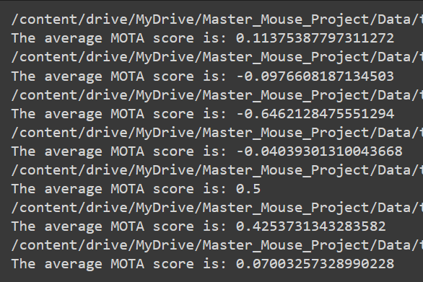
Comparative previous results to new results MOTA

Slide 11
QUESTIONS

